Slide 1
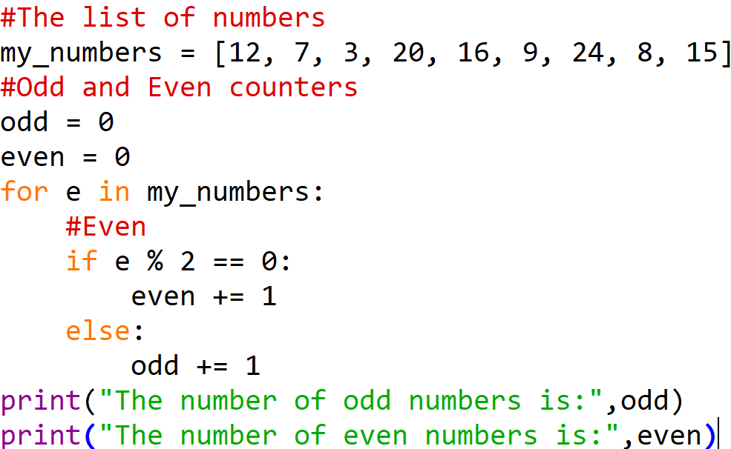
Homework Solution – For Loop

Slide 2
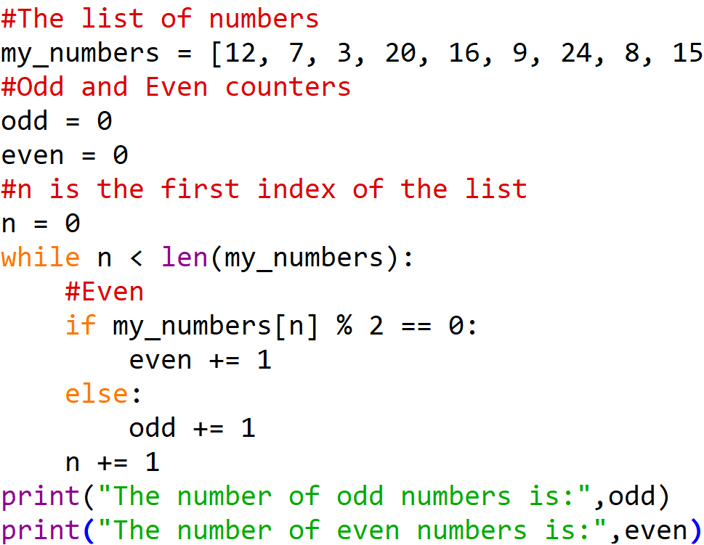
Homework Solution – While Loop

Slide 3
Fundamentals Part 4

Slide 4
Content
Functions
Common Libraries
NumPy (Numerical Python)
Pandas
Matplotlib

Slide 5
Introduction to functions
Main purpose is to perform a specific task with a block of code
Function is a mini program within the main program
Why use
Functions allow automation and prevent repetitive steps
Simplify code
Increase readability

Slide 6
Function Analogies
Real-world analogies
Recipe – Function like recipe in cooking, takes in ingredients(input), performs a series of steps(code), then produces a dish (output)
Library – Function like borrowing a book at a library, you can use it whenever you need without having to rewrite it each time

Slide 7
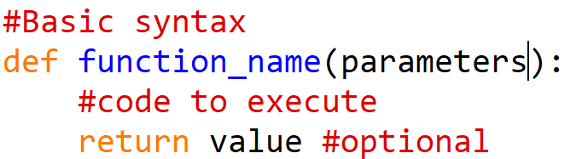
Syntax and Components of functions
def – start of function definition
function_name – Name of function
parameters - Input/s to function (OPTIONAL)
return – Used to return a value from function (OPTIONAL)

Slide 8
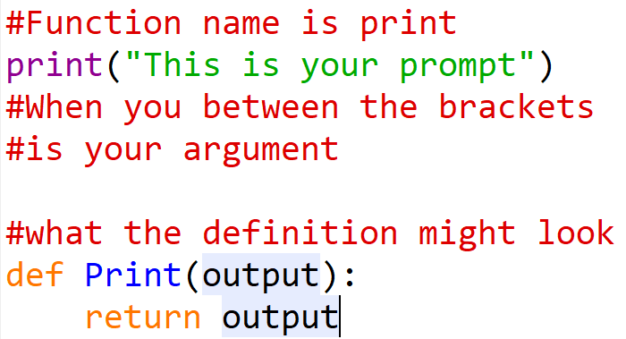
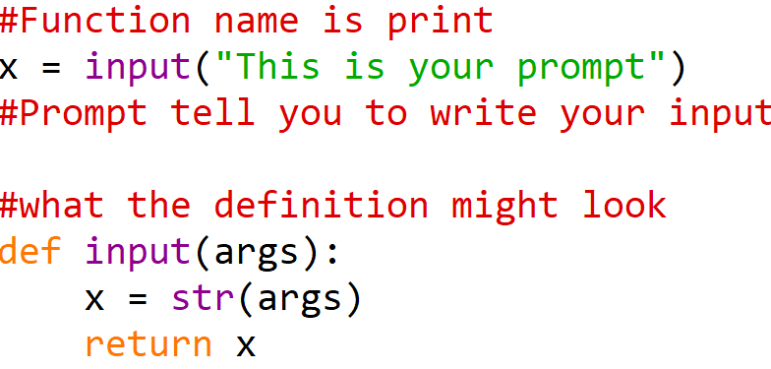
Examples of functions you’ve already seen
Print
Input

Slide 9
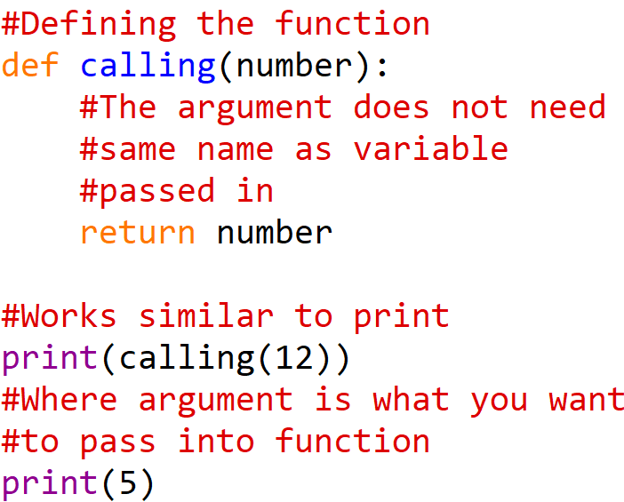
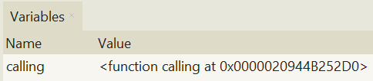

Calling functions

Slide 10
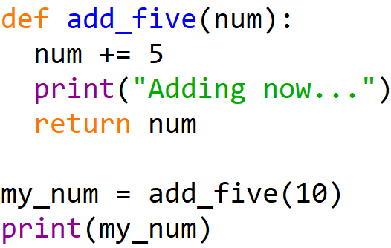

Returning values
It is optional to return a value
If you don’t define the return value it will default, return None

Slide 11
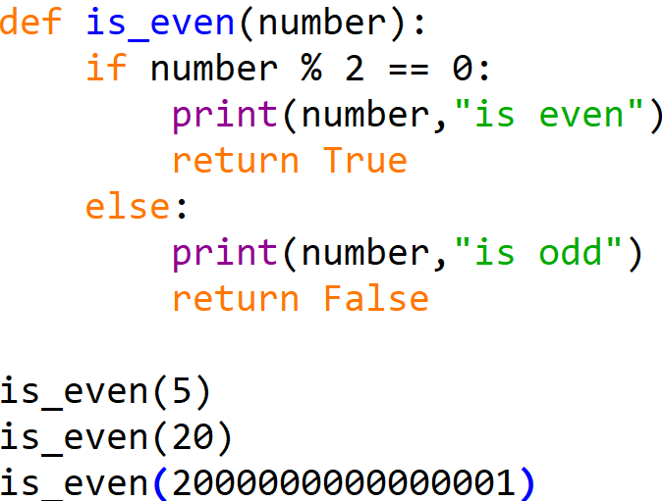
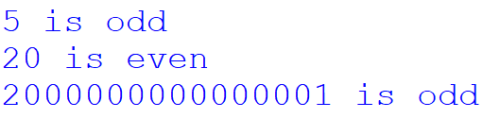
Example 1 – Is even

Slide 12
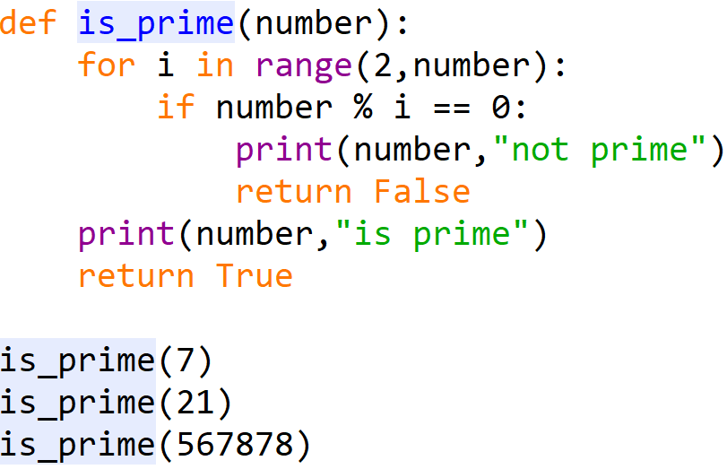
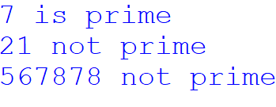
Example 2 – Is Prime

Slide 13
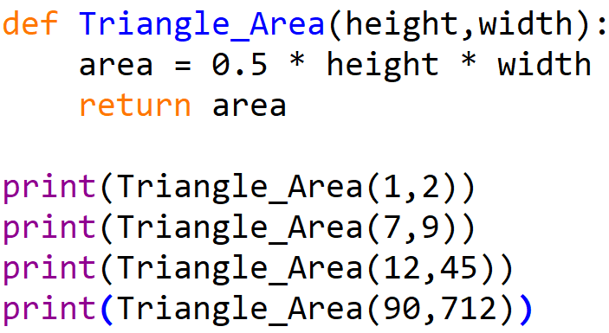
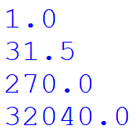
Example 3 – Triangle area

Slide 14
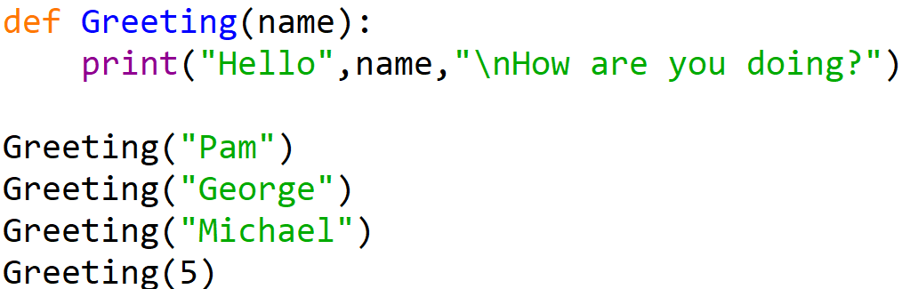
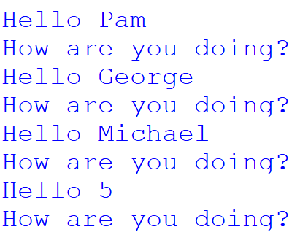
Example 4 – Greeting

Slide 15
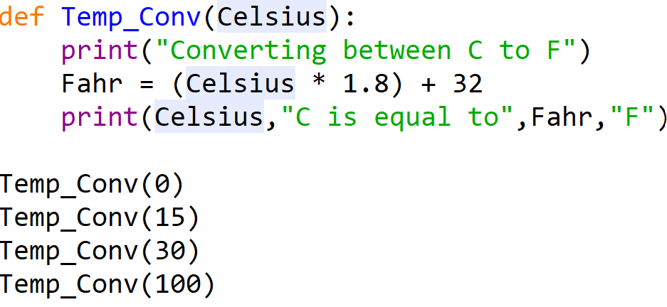
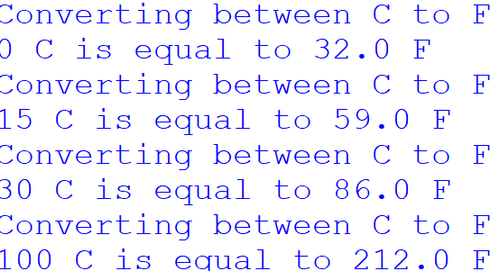
Example 5 – Temperature conversion

Slide 16
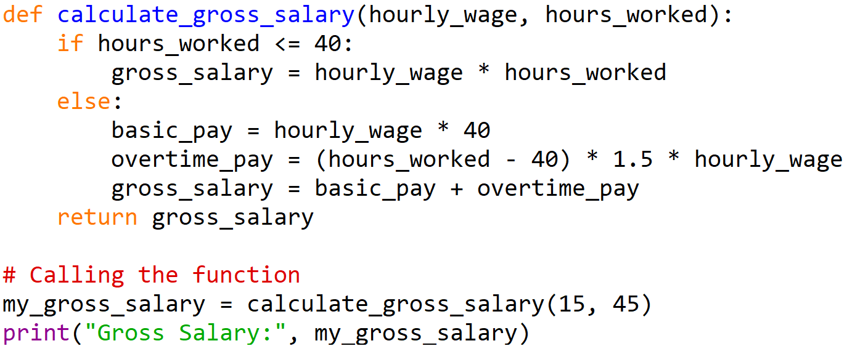
Example 6 – Real World

Slide 17
NumPy – Numerical Python
Powerful library for data manipulation and analysis
Easy to use data structures and functions to work with structured data
For tasks like
Cleaning
Transforming
Analyzing data more efficient and intuitive

Slide 18
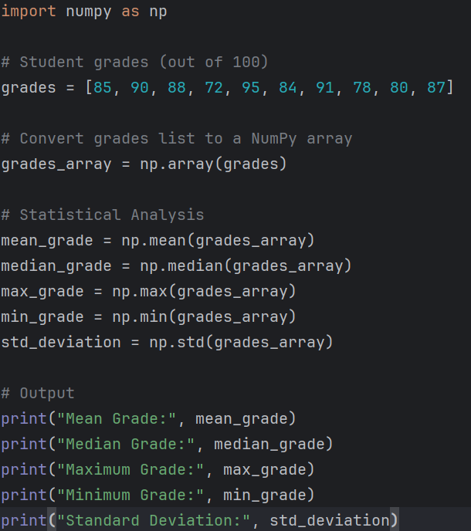
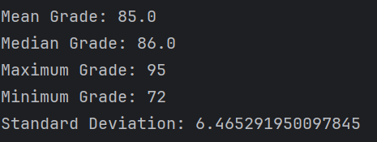
NumPy – Numerical Python: Example 1

Slide 19
Pandas
Powerful library for numerical computing
Support for large multidimensional arrays and matrices
Support for collection of mathematical functions to operate on these array(lists)
Uses:
Scientific Computing, Data Analysis, Machine Learning applications

Slide 20
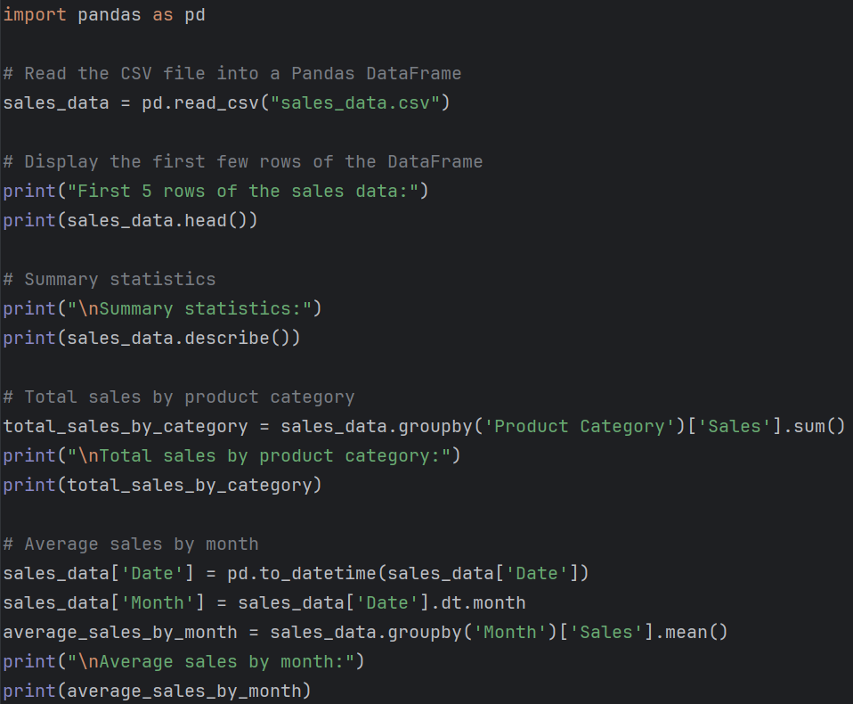
Pandas - Example 1

Slide 21
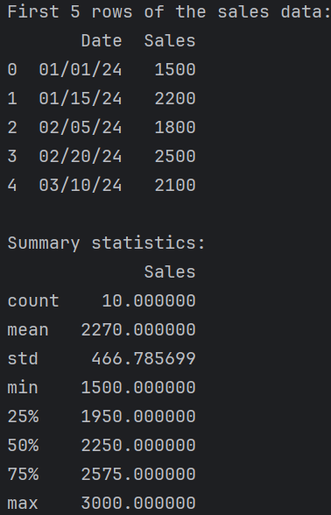
Pandas – Example 1

Slide 22
Matplotlib
Powerful library for creating static, interactive and animated visualizations
Plotting functions to generate high quality graphs, charts and figures for data exploration and presentation purposes
Customize every aspect of plots to effectively communicate their data insights

Slide 23
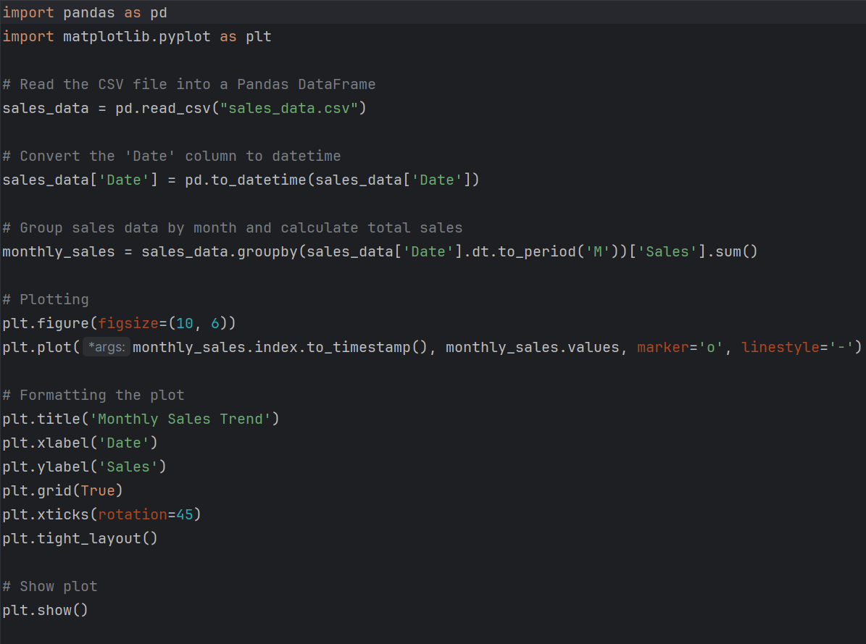
Matplotlib - Example 1

Slide 24
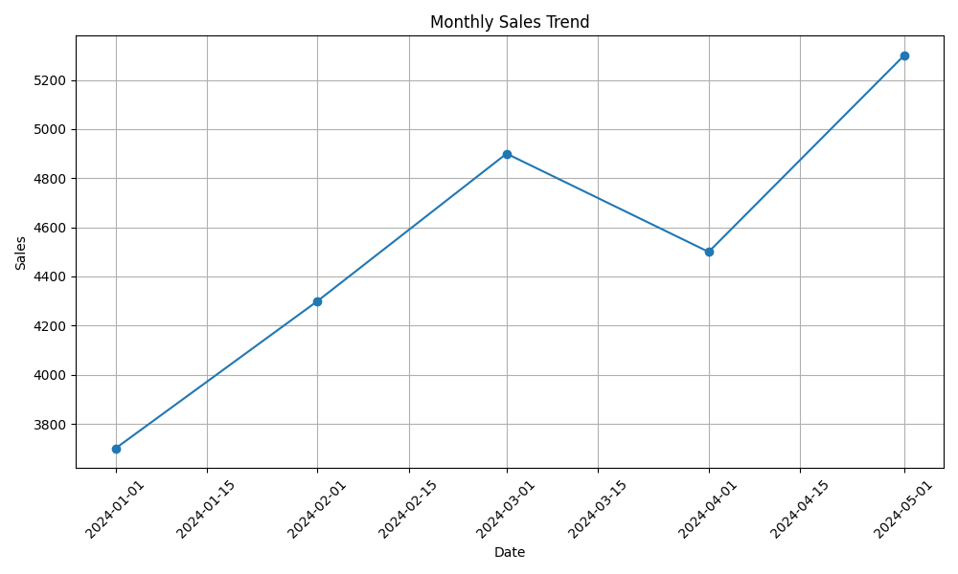
Matplotlib – Example 1

